Slide 1

Software failure tolerant/highly available distributed class management system (dcms)
TEAM MEMBERS: Professor:
Sagar vetal (40071979) Mohamed Taleb
Himanshu kohli (40070839)
Khayatibahen Chaudhary (40071098)
Zankhanaben patel (40067635)

Slide 2
Agenda
Objective
Design
Implementation
FRONT END
HEARTBEAT DETECTION
FIFO MECHANISM
BULLY ALGORITHM
Conclusion

Slide 3
Objective
Highly available CORBA Distributed Class Management System, which tolerates process crashes only (no software bugs) using unreliable failure detection.
There are group of three servers processes and three replicas providing redundancy for highly available and periodically checking each other for failure detection.
We have to implement bully algorithm to elect new leader from slave replicas in case of primary replica failure
FIFO broadcast mechanism leader replicas atomically send client request to slave replicas in the same sequence in the order of received operation, receives response from them and sends single response to front end.

Slide 4
Architecture diagram

Slide 5
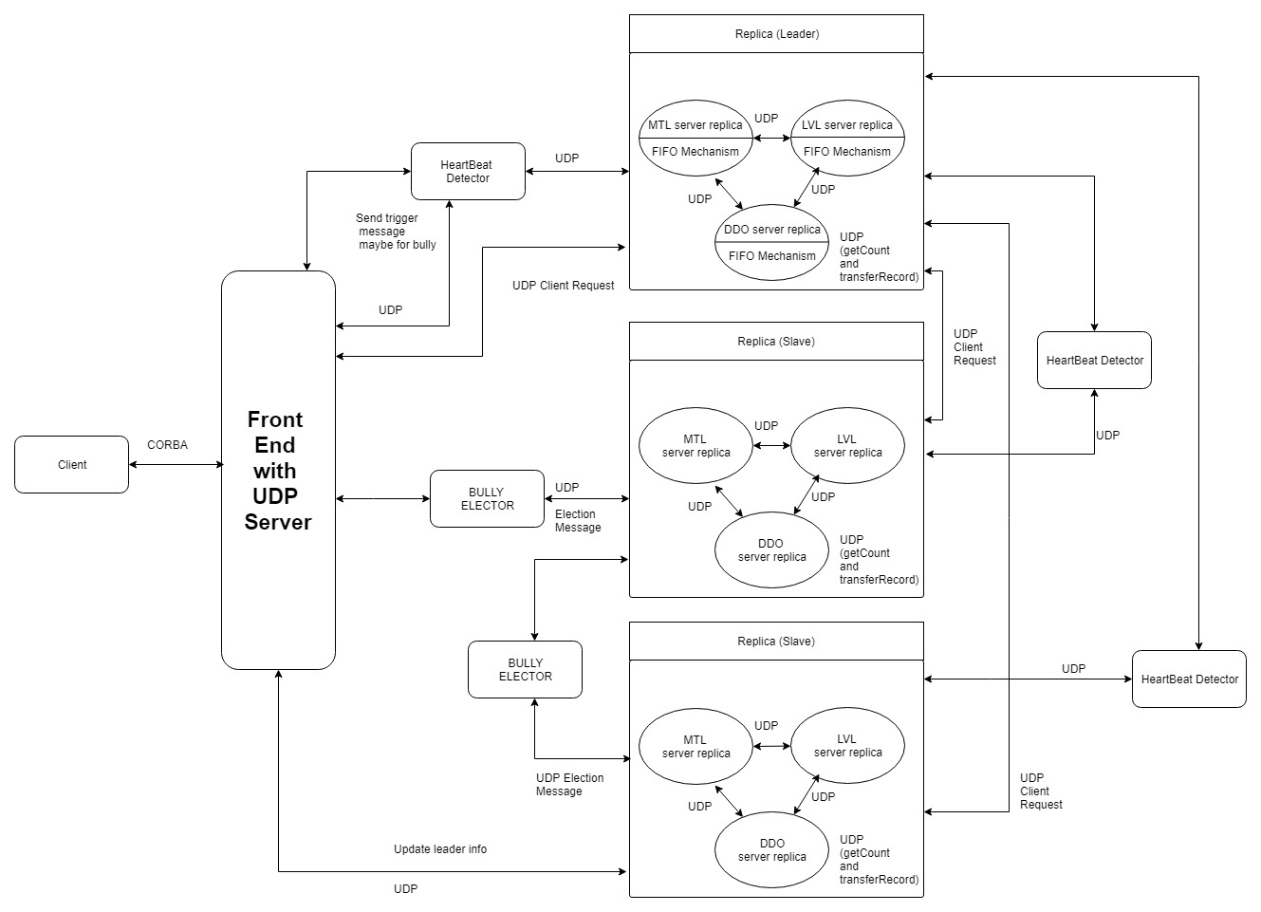

Slide 6
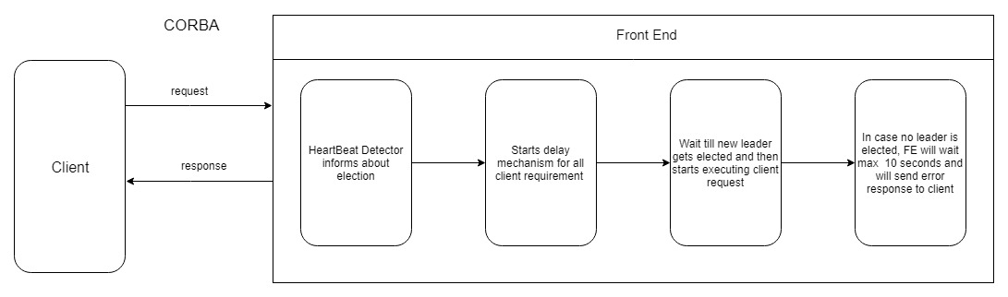
Front End

Slide 7
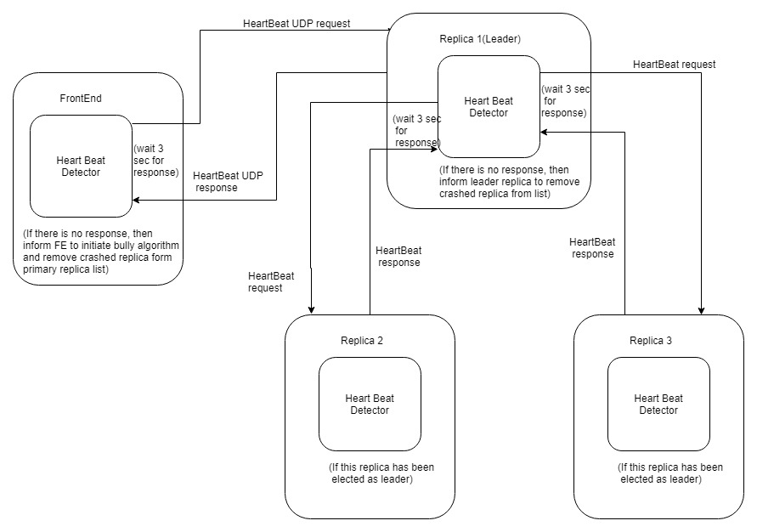
Heartbeat detection

Slide 8
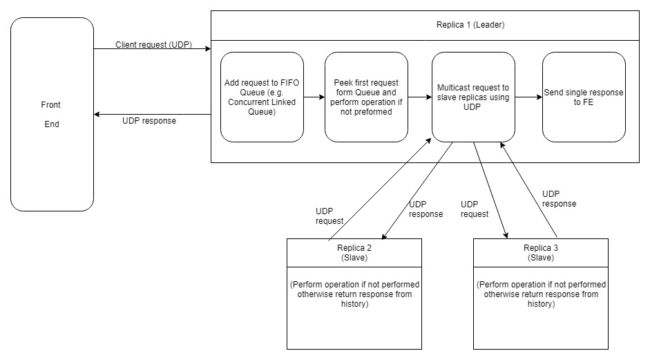
FIFO mechanism

Slide 9
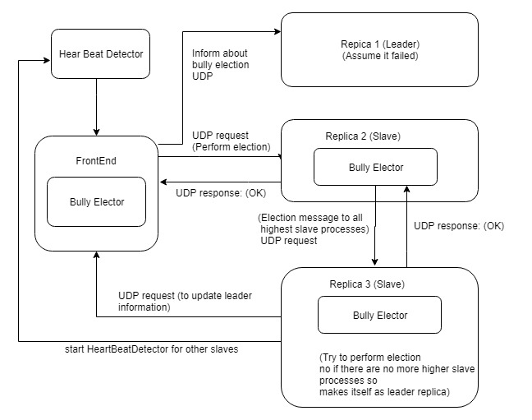
Bully algorithm

Slide 10
conclusion

Slide 11
Advantages and disadvantages
Simple implementation
High Level of Transparency
Highly reliable: Data integrity on all server and its replications
Data security
Inefficient systems as data security cost system delays
Cannot survive all system crashes
Passive replication does not allow system to be added in the server set again

Slide 12
Proposed advancements
For highly reliable system active replication must be interchanged with passive replication (avoid byzanite effect)
Optimistic replication must be used in the systems

Slide 13
Thank You

